Slide 1
CSE 305 Computer Architecture Introduction
Prepared by
Madhusudan Basak
Assistant Professor
CSE, BUET

Slide 2

Class Introduction
3 credit course
3 classes/week
Sunday (9 AM),
Monday (10 AM) and
Wednesday (8 AM! It’s sleeping time for many!)
Can be change based on previous declaration
4 Class Tests will be taken and BEST 3 will be counted

Slide 3
Evaluation Criteria
3 credit course – Total 300 Marks
Attendance – 10%
Class Test – 20%
Term Final Exam – 70%

Slide 4
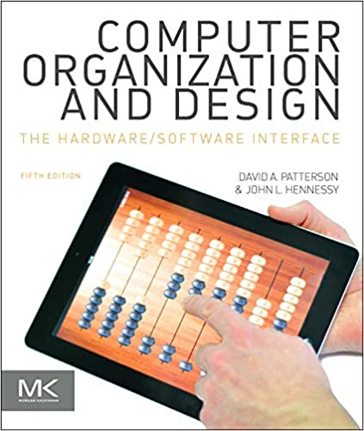
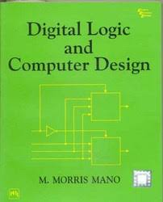
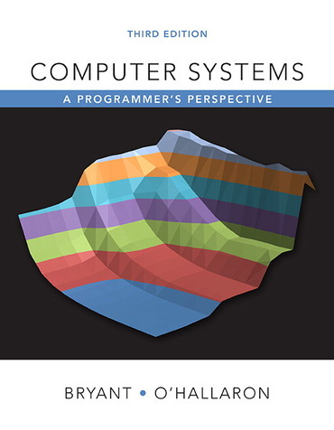
Reference Books
Computer Organization and Design (5th Edition)
Will be used for most of the topics
Digital Logic and Computer Design (3rd Edition)
Will be used for some topics
Computer Systems
A Programmer’s Perspective (3rd Edition)
Will be used for some topics

Slide 5


Why Computer Architecture?
To apply the Architectural sense to a computer
To apply computer for Architectural design
To know about the basic Architecture of a computer

Slide 6
Why Computer Architecture?
Purpose
How hardware (processors, memories, disk drives, network infrastructure) plus software (operating systems, compilers, libraries, network protocols) combine to support the execution of application programs
How you as a programmer can best use these resources

Slide 7

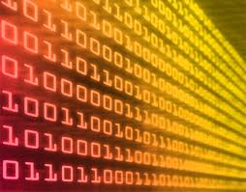
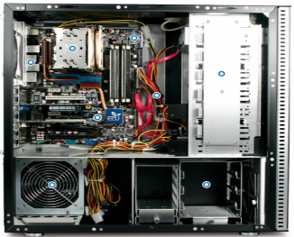
Why Computer Architecture?

Slide 8

What to know?
What the computer does
How it does
Logical View
Instruction Set Architecture (ISA)
Physical View
Computer Organization
Computer Architecture
Instruction Set Architecture
Computer Organization

Slide 9
Instruction Set Architecture
Instruction set architecture is the attributes of a computing system as seen by the assembly language programmer or compiler.
Instruction Set (what operations can be performed?)
Instruction Format (how are instructions specified?)
Data storage (where is data located?)
Addressing Modes (how is data accessed?)
Exceptional Conditions (what happens if something goes wrong?)

Slide 10
Machine Organization
Machine organization is the view of the computer that is seen by the logic designer. This includes
Capabilities & performance characteristics of functional units (e.g., registers, ALU, shifters, etc.)
Ways in which these components are interconnected
How information flows between components
Logic and means by which such information flow is controlled
Coordination of functional units

Slide 11
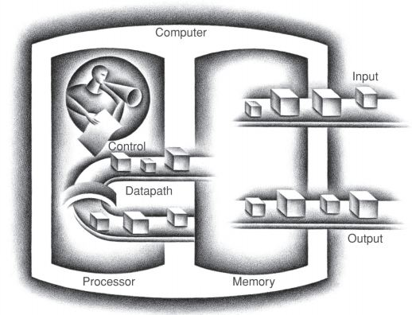
Components of a Computer

Slide 12
Components of a Computer
Control
Gives directions to the other components
e.g., bus controller, memory interface unit
Datapath
Performs arithmetic and logic operations
e.g., adders, multipliers, shifters
Memory
Holds data and instructions
e.g., cache, main memory, disk
Input
Sends data to the computer
e.g., keyboard, mouse
Output
Gets data from the computer
e.g., screen, sound card

Slide 13
Information in a computer -- Instructions
Instructions specify commands to
Transfer information within a computer
e.g., from memory to ALU
Transfer of information between the computer and I/O devices
e.g., from keyboard to computer, or computer to printer
Perform arithmetic and logical operations
e. g., add two numbers, perform a logical AND

Slide 14
Information in a computer -- Instructions
A sequence of instructions to perform a task is called a program, which is stored in the memory.
Processor fetches instructions from the memory and performs the operations stated in those instructions.
What do the instructions operate upon?

Slide 15
Information in a computer -- Data
Data are the “operands” upon which instructions operate.
Data could be:
Numbers,
Encoded characters.
Data, in a broad sense means any digital information.
Computers use data that is encoded as a string of binary digits called bits.

Slide 16
Classes of Computers
Desktop / Notebook Computers
Low-end systems, high performance workstations.
Subject to cost/performance tradeoff
Server Computers
Network based
High capacity, performance, reliability
Range from small servers to building sized
Embedded Computers
Hidden as components of systems
Minimize memory and power. Often not programmable

Slide 17
Eight Great Ideas in Computer Architecture
Design for Moore’s Law
Use Abstraction to Simplify Design
Make the Common Case Fast
Performance via Parallelism
Performance via Pipelining
Performance via Prediction
Hierarchy of Memories
Dependability via Redundancy

Slide 18

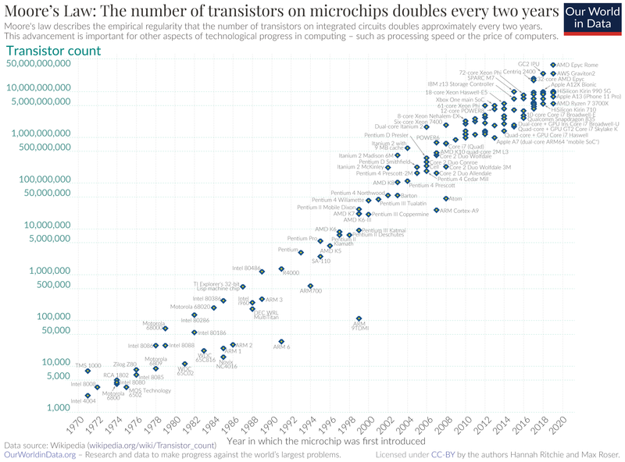
Design for Moore’s Law
Provided by Gordon Moore (co-founder of Intel) in 1965
Moore's law is the observation that the number of transistors in a dense integrated circuit (IC) doubles about every two years.

Slide 19

Use Abstraction to Simplify Design
Computing system maintains a hierarchical structure
Lower-level details are hidden to the higher levels
Higher level only gets the abstract view
Both Hardware and Software consist of hierarchical layers using abstraction

Slide 20

Make the Common Case Fast
More efficiency in common case, more impact in overall design.

Slide 21

Performance via Parallelism
Current multi processor system exploits parallelism.
Often needs special care for coordination.
x = a + b
y = c*d
x = a + b
y = x*d

Slide 22


Performance via Pipelining
Pipelining
A special case of parallelism
Performing multiple non-dependent operations at the same time
A
B
C

Slide 23

Performance via Prediction
Perform operation just based on prediction/assumption
Applicable when the impact is not costly

Slide 24

Hierarchy of Memories
We want faster and cheaper memory
Faster memory is costlier
Cheaper memory is slower
Trade-off is memory hierarchy

Slide 25

Dependability via Redundancy
Redundancy means keeping multiple copies
One fails, another exists => Dependable

Slide 26
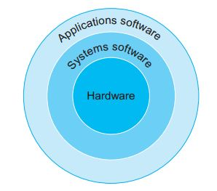
Hierarchical Structure of Program Execution
Simplified view including Hardware
e.g., MS Word, Powerpoint
e.g., Compiler, Operating System
e.g., CPU, HDD, RAM

Slide 27
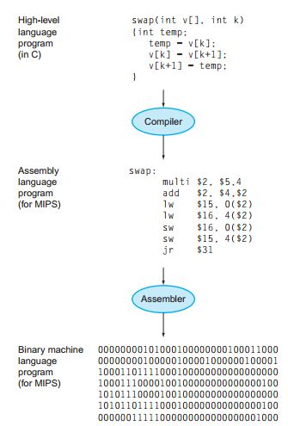
Software Abstraction
Hierarchical structure for a
program execution
A + B
Add A, B
1000110010100000

Slide 28
Hardware Abstraction: Memory
CPU Registers
Main Memory
(DRAMS)
Optical Disks
Cache Memory
(SRAMS)
Magnetic Disks
Magnetic Tapes
Memory Hierarchy
Volatile
Increased speed and cost
Non-Volatile

Slide 29
Simplified overall abstraction
Application S/W
Application Software
Compiler, Assembler, Linker, Loader
Executable Program
Executable Program
Executable Program
Operating System
Process
Instruction Set Architecture
Virtual Memory
File
Hardware
Processor
Main Memory
I/O Devices

Slide 30
Performance
What is the metric of the performance of a computing system?
Depends on the purpose
Two commonly used metrics are:
Execution or Response Time
How long it takes to do a task
Throughput
Total work done per unit time
e.g., tasks/transactions/… per hour
Are these two same?

Slide 31
Example
Do the following changes to a computer system increase throughput, decrease response time, or both?
Replacing the processor in a computer with a faster version
Response time decreases or improves
Decreasing response time generally increases throughput
Adding additional processors to a system that uses multiple processors for separate tasks—for example, searching the web
Throughput increases
Response time depends on scenario
Generally no impact on response time
But in case tasks were waiting in the queue previously, response time will decrease after the change

Slide 32
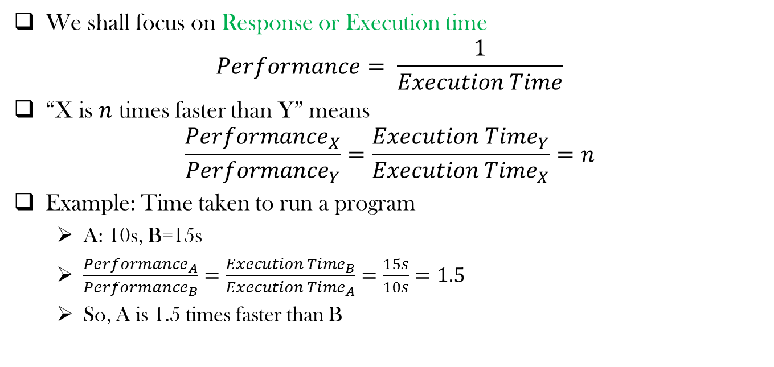
Relative Performance
We shall focus on Response or Execution time
$$Performance= \frac{1}{Execution Time}$$
“X is $n$ times faster than Y” means
$$\frac{{Performance}_{X}}{{Performance}_{Y}}=\frac{{Execution Time}_{Y}}{{Execution Time}_{X}}=n$$
Example: Time taken to run a program
A: 10s, B=15s
$\frac{{Performance}_{A}}{{Performance}_{B}}=\frac{{Execution Time}_{B}}{{Execution Time}_{A}}=\frac{15s}{10s}=1.5$
So, A is 1.5 times faster than B

Slide 33
Measuring Execution Time
Elapsed time
Counts everything (disk and memory accesses, I/O, operating system overhead etc.)
A useful number, but often not good for comparison purposes
Time sharing among multiple programs
CPU time
Doesn’t count I/O or time spent in running other programs
Can be broken into system CPU time and user CPU time
Our focus: user CPU time
CPU time spent in executing the lines of code that are “in” our program

Slide 34


Clock Cycles
Time is not continuous, rather discrete to a Computer’s perspective
Activities are performed during the discrete clock ticks
cycle time = time between ticks = seconds per cycle
clock rate (frequency) = cycles per second (1 Hz. = 1 cycle/sec) A 2 Ghz. clock has a 1 / 2×10⁹ = 0.5 nano-second (ns) cycle time
So, for a program
time
$$CPU Time =CPU clock cyles ∗Clock cycle time$$
$$CPU Time =\frac{CPU clock cyles}{Clock rate}$$

Slide 35


Clock Cycles
For a program
Performance improvement means
Decreasing number of clock cycles
Increasing clock rate
Hardware designer often trade off clock rate against cycle count
$$CPU Time =CPU clock cyles ∗Clock cycle time$$
$$CPU Time =\frac{CPU clock cyles}{Clock rate}$$

Slide 36
CPU Time Example
Computer A: 2GHz clock, 10s CPU time
Designing Computer B
Aim for 6s CPU time
Can do faster clock, but causes 1.2 × clock cycles
How fast must Computer B clock be?

Slide 37
Instructions vs Cycles
Is the number of cycles identical with the number of instructions?
No!

Slide 38
Why?
Operations take different time
Multiplication takes longer than addition
Floating point operations take longer than integer operations
The access time to a register is much shorter than to memory location

Slide 39


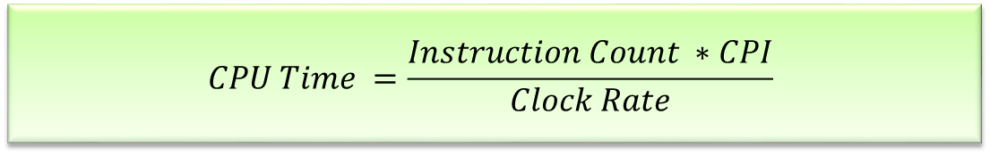
Instruction Count and CPI
$$CPU Time =CPU clock cyles ∗Clock cycle time$$
$$CPU clock cyles=Instruction Count ∗CPI$$
$$CPU Time =Instruction Count ∗CPI∗Clock cycle time$$
$$CPU Time =\frac{Instruction Count ∗CPI}{Clock Rate}$$

Slide 40
Instruction Count and CPI
Instruction Count for a program
Determined by program, ISA and compiler
CPI is an average since the number of cycles per instruction varies from instruction to instruction
CPI varies by application, as well as among implementation with the same instruction set
Number of cycles for each instruction
Frequency of instructions (instruction mix)
Memory access time

Slide 41
CPI Example
Computer A: Cycle Time = 250ps, CPI = 2.0
Computer B: Cycle Time = 500ps, CPI = 1.2
Same ISA
Which is faster, and by how much?
A is faster…
…by this much

Slide 42
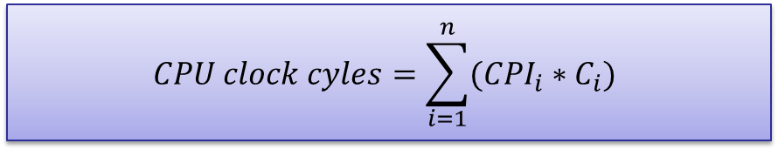

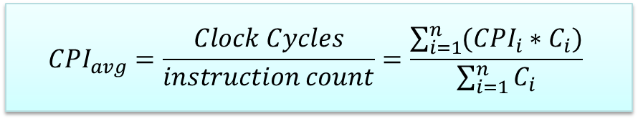
Program Execution time
$$CPU clock cyles=Instruction Count ∗CPI$$
$$CPU clock cyles=\sum_{i=1}^{n}{({CPI}_{i}∗C_{i})}$$
$${CPI}_{avg}=\frac{Clock Cycles}{instruction count}=\frac{\sum_{i=1}^{n}{({CPI}_{i}∗C_{i})}}{\sum_{i=1}^{n}{C_{i}}}$$

Slide 43
CPI Example
Alternative compiled code sequences using instructions in classes A, B, C
Class | A | B | C
CPI for class | 1 | 2 | 3
IC in sequence 1 | 2 | 1 | 2
IC in sequence 2 | 4 | 1 | 1
Sequence 1: IC = 5
Clock Cycles = 2×1 + 1×2 + 2×3 = 10
Avg. CPI = 10/5 = 2.0
Sequence 2: IC = 6
Clock Cycles = 4×1 + 1×2 + 1×3 = 9
Avg. CPI = 9/6 = 1.5

Slide 44
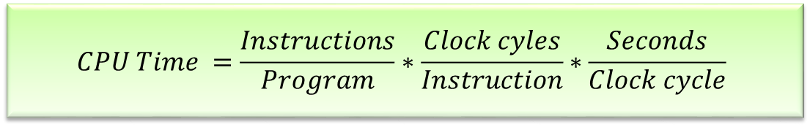
Performance Summary
The BIG Picture
Performance depends on
Algorithm
Programming language
Compiler
Instruction set architecture
$$CPU Time =Instruction Count ∗CPI∗Clock cycle time$$
$$CPU Time =\frac{Instructions}{Program}∗\frac{Clock cyles}{Instruction}∗\frac{Seconds}{Clock cycle}$$

Slide 45
Tradeoffs
Instruction count, CPI, and clock cycle present tradeoffs
RISC – reduced instruction set computer (MIPS)
Simple instructions
Higher instruction counts for an application
Lower CPI
CISC – complex instruction set computer (IA-32)
More complex instructions
Lower instruction counts for an application
Higher CPI

Slide 46
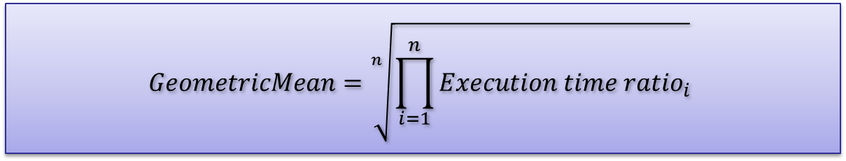
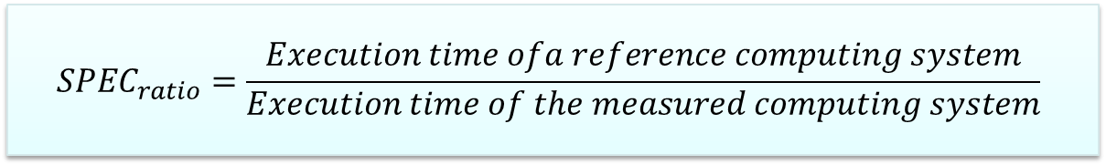
Comparing Computing Systems
Comparing systems => comparing execution time of the workload is required
Benchmarks can also help to evaluate measure the performance
12 benchmarks of SPECINTC2006 are given in the next slide
SPECratio can be used to measure the performance
The geometric mean of the SPECratios (of the Benchmarks) can be calculated
$${SPEC}_{ratio}=\frac{Execution time ofa reference computing system}{Execution time of the measured computing system}$$
$$GeometricMean=\sqrt[n]{\prod_{i=1}^{n}{{Execution time ratio}_{i}}}$$

Slide 47
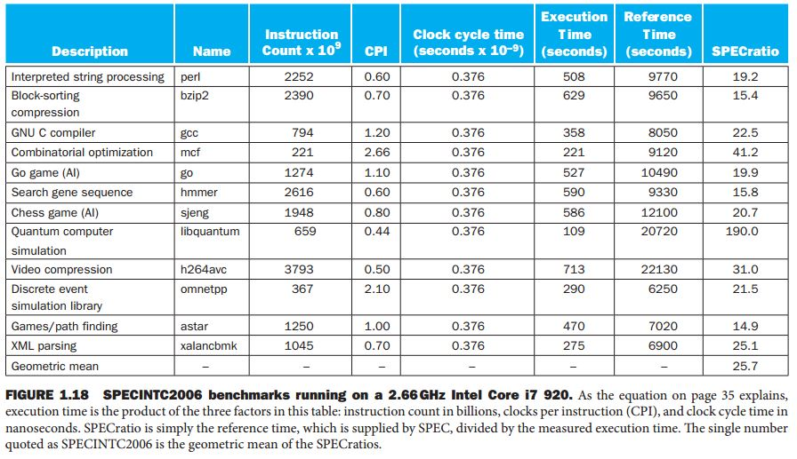
Benchmarks

Slide 48
Fallacies and Pitfalls
Fallacy
Commonly held misconceptions
Pitfall
a hidden or unsuspected danger or difficulty
Easily made mistakes

Slide 49
Fallacies
Fallacy 1
Fallacy 2
Computers at low utilization use little power
Designing for performance and designing for energy efficiency are unrelated goals

Slide 50
Pitfalls
Pitfall 1
Pitfall 2
Expecting the improvement of one aspect of a computer to increase overall performance by an amount proportional to the size of the improvement.
Using a subset of the performance equation as a performance metric.

Slide 51
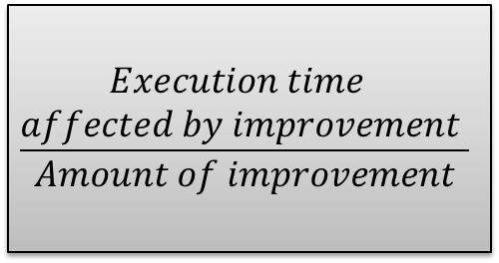


Amdahl’s Law
$$\frac{\begin{aligned}Execution time \\ affected by improvement \end{aligned}}{Amount of improvement}$$
$$Execution time$$
$$unaffected$$
$$Execution time$$
$$after improvement$$

Slide 52
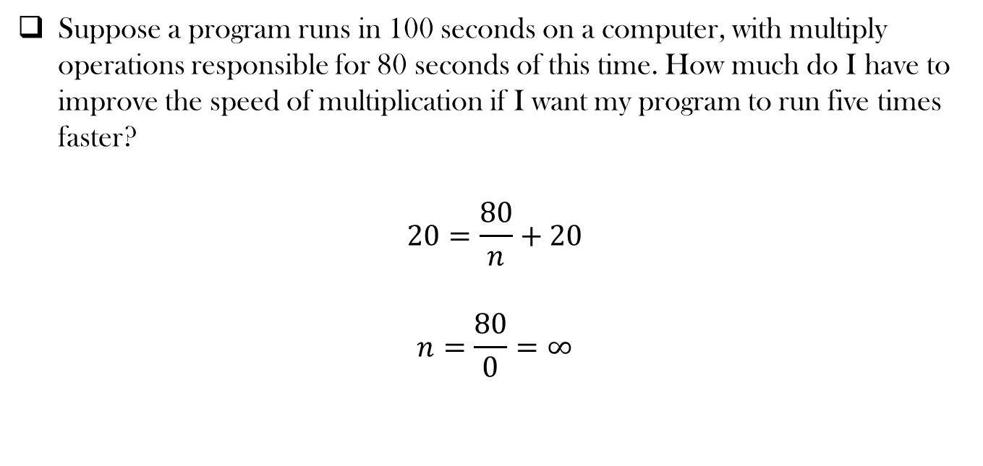
Example
Suppose a program runs in 100 seconds on a computer, with multiply operations responsible for 80 seconds of this time. How much do I have to improve the speed of multiplication if I want my program to run five times faster?
$$20=\frac{80}{n}+20$$
$$n=\frac{80}{0}=∞$$

Slide 53
Acknowledgements
These slides contain material developed and copyright by:
Krste Asanovic (UCB), James Hoe (CMU), Li-Shiuan Peh (MIT), Sudhakar Yalamanchili (GATECH), and Amirali Baniasadi (UVIC) in part of their respective courses
Lecture slides by Dr. Tanzima Hashem, Professor, CSE, BUET
Lecture slides by Ms. Mehnaz Tabassum Mahin, Assistant Professor, CSE, BUET

Slide 54
Thank You ☺

